Slide 1
Bioenergetics and Metabolism: Introduction: - The cytoplasmic organelles are provided specialized compartments in which a variety of metabolic activities are taking place. The cytoplasmic organelles ether membrane-bound structures in a cell such as a nucleus, or organelles located in the cytoplasm such as mitochondria, chloroplasts, endoplasmic reticulum, Golgi apparatus, lysosomes and vacuoles.

Slide 2
The generation of metabolic energy is a major activity of all cells, and two cytoplasmic organelles are specifically devoted to energy metabolism and the production of ATP; Mitochondria and chloroplast. 1- Mitochondria are responsible for the generation of the most useful energy derived from the breakdown of lipids and carbohydrates.

Slide 3
2- The Chloroplasts, which are use energy captured from sunlight to generate both ATP and power that needed to synthesize carbohydrates from C02 and H20.
Chloroplasts are similar to mitochondria, in which the surface of it contain both outer and inner membranes.

Slide 4
Mitochondria
- Mitochondria play a critical role in the generation of metabolic energy in eukaryotic cells.
- They are responsible of the most useful energy derived from the breakdown of carbohydrates and fatty acids, which is converted to ATP by the process of oxidative phosphorylation.

Slide 5
Most mitochondrial proteins are translated on free cytosolic ribosomes and imported into the organelle by specific targeting signals.
Organization of Mitochondria
- Mitochondria are surrounded by a double-membrane system, consisting of inner and outer
mitochondrial membranes that separated by an intermembrane space.

Slide 6
- The inner membrane forms numerous
folds (cristae), which extend into the interior (or matrix).
1- Mitochondrial outer membrane:
The outer membrane is highly permeable to small molecules because it contains proteins called porins that form channels, which allowing free diffusion of molecules.

Slide 7
2- Mitochondrial inner membrane:
The inner membrane contains a high percentage of proteins involves in oxidative phosphorylation processes.
3- Intermediate space:
The intermediate space is similar to the cytosol but with respect to ions and small molecules.
4- The matrix: contains the mitochondrial genetic system as well as the enzymes responsible for the central reactions of oxidative metabolism.

Slide 8
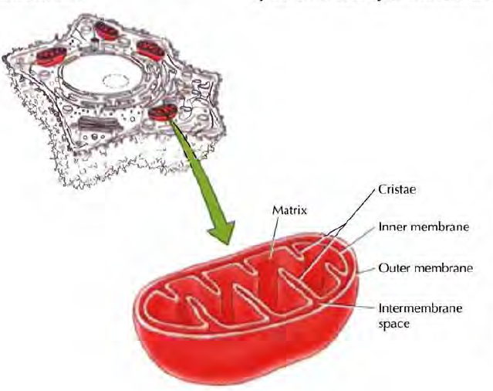
Mitochondria

Slide 9
The genetic system of mitochondria:
Mitochondria have its own DNA which is a circular molecule.
Mitochondrial DNA has a genome encode only a small number of proteins that essential for the oxidative phosphorylation system and also encode for rRNAs and tRNA that’s needed for translation of these proteins within the mitochondria.

Slide 10
Chromosome Structure
Proteins organize DNA structurally, allowing chromosomes to pack tightly. this proteins called Histones
Histone: Type of protein that structurally organizes eukaryotic chromosomes.
Histones is packed in group of 8, and this called nucleosome
Nucleosome: A length of DNA wound around a spool of histone proteins

Slide 11
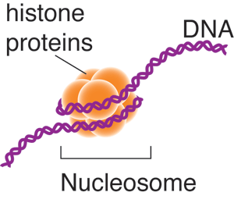
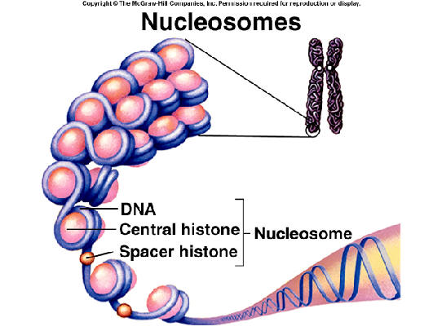
Chromosome Structure

Slide 12
Chromatid: is one copy of a duplicated chromosome, which is generally joined to the other copy by a single centromere.
Centromere: is constricted region in a eukaryotic chromosome where sister chromatids are attached.
They divide the chromatids into two arms
1- short arm known “ p” arm.
2- The long arm known “ q” arm

Slide 13
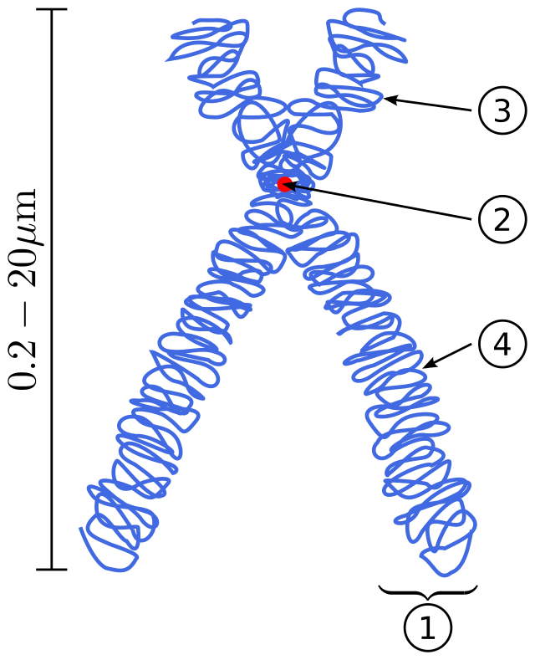
Scheme of a Chromosome. (1) Chromatid: One of the two identical parts of the chromosome after S phase. (2) Centromere: The point where the two chromatids touch, and where the microtubules attach. (3) Short arm “p”(4) Long arm”q”.

Slide 14
Chromosome Number
A eukaryotic cell’s DNA is divided into a characteristic number of chromosomes. For instance, a human body cell has 23 pairs of chromosomes
Types of Chromosomes
There are two types of eukaryotic chromosomes: autosomes and sex chromosomes
Autosomes: Paired chromosomes with the same length, shape, centromere location, and genes
Sex chromosomes: Members of a pair of chromosomes that differ between males and females

Slide 15
Sex Chromosomes:
Sex Determination in Humans
Diploid cell: is a cell that contains two sets of chromosomes. One set of chromosomes is donated from each parent.
Examples: The diploid number of a cell is the number of chromosomes in the cell. This number is commonly abbreviated as 2n, where n stands for the number of chromosomes. For humans this equation would be 2n=46.

Slide 16
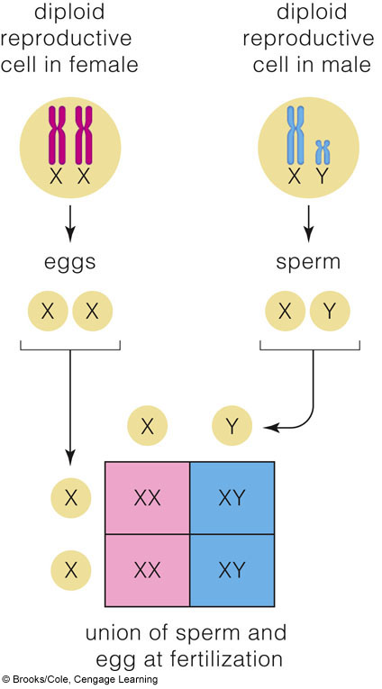
Sex Determination in Humans:

Slide 17
Karyotype
Karyotyping reveals characteristics of an individual’s chromosomes
Karyotype
Image of an individual’s complement of chromosomes arranged by size, length, shape, and centromere location.
Constructing a Karyotype
Karyotype tells three facts of an individual:
1- The gender of an individual:
(XX) Female
(XY) Male
2-The species of an individual:
Human has 23 pairs of chromosomes (22 autosome and one pair sex chromosomes)
3- If the individual has chromosome disorder.

Slide 18
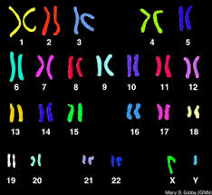
Constructing a Karyotype

Slide 19
Thanks

